Slide 1
The Jump Start unit planning model
Notes:
Updated Jan 2012
© 2012 Centre for Academic and Faculty Enrichment

Slide 2
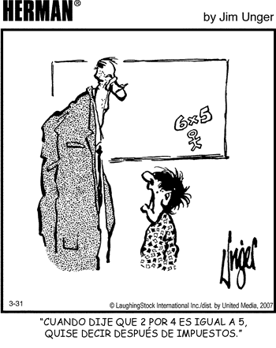
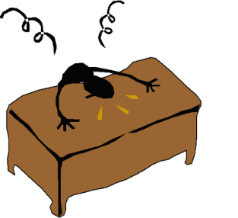
“They don’t give us time to learn anything; we have to listen to the teacher all day!”
This can be a problem online as well!

Slide 3
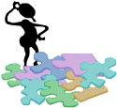
Active learning
Active learning strategies can be used to…
Engage students’ interest
Deliver content
Review content
Co-create knowledge
Make information meaningful
Connect students to each other
Connect students to the instructor
Ecourage students to practice skills and knowledge
Enable students to check their developing mastery via instant feedback

Slide 4
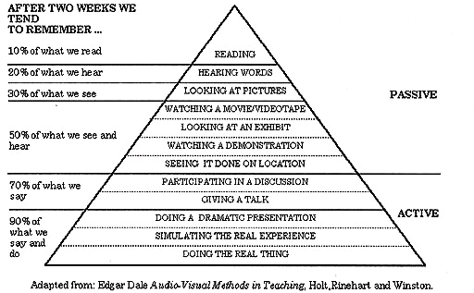
Active learning works!

Slide 5
Teaching to learning styles
How can we integrate learning activities into a coherent model?
Using a model based on learning styles can help…

Slide 6
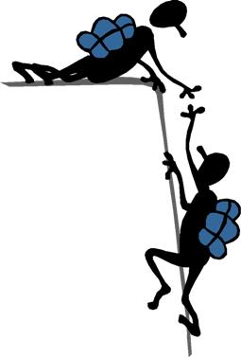
Kolb’s Learning Styles
David Kolb’s research indicates that people learn primarily in one of four styles.
We can all benefit from information presented in all 4 ways, but prefer one of the four if given a choice.
Teaching in ways that address all four styles maximizes the potential for all students to learn; all benefit from the repetition/ different approaches

Slide 7
Kolb Learning Style Inventory
Based on 4-stage learning cycle
Concrete Experience (CE): learning from feeling and personal involvement
Reflective Observation (RO): learning by watching and listening
Abstract Conceptualization (AC): learning by thinking
Active Experimentation (AE): learning by doing

Slide 8
FOUR Learning Styles
Style 1: the Diverger
Concrete Experience + Reflective Observation
Style 2: the Assimilator
Abstract Conceptualization+ Reflective Observation
Style 3: the Converger
Abstract Conceptualization+ Active Experimentation
Style 4: the Accommodator
Concrete Experience + Active Experimentation

Slide 9
Kolb's learning styles
and
cycle
Concrete Experience
Feeling
Accommodating
(feel and do)
CE/AE Style 4
Diverging
(feel and watch)
CE/RO Style 1
Perception Continuum
how we think about things
Active Experimentation Doing
Processing Continuum
how we do things
Reflective Observation Watching
Converging
(think and do)
AC/AE Style 3
Assimilating
(think and watch)
AC/RO Style 2
Abstract Conceptualisation Thinking

Slide 10
Style 1: the Diverger (feeling and watching)
Why should I learn this?
What do I already know about this?
How will I use this?
Why does this matter?
Who will it affect?
imaginative
artistic
sensitive
Convince me to learn!
BLUE

Slide 11
Style 2: the Assimilator (thinking and watching)
What do you want me to know?
What is the information?
What are the steps in the process?
What is the correct answer?
ideas
concise
Gimme the goods!
logical
GOLD

Slide 12
Style 3: the Converger (thinking and doing)
How do I do this?
Have you tested this out?
What happens if I do this…?
Can I try it?
experimental
technical
problem
solving
Lemme get my hands on it!
ORANGE

Slide 13
Style 4: the Accommodator (doing and feeling)
What is everyone’s feeling on this?
How might this relate to that…?
How will this work in the big picture?
What information do others have?
practical
intuitive
Now let’s explore this together…
team
based
GREEN

Slide 14
So, how do I teach to these styles?
Style 1: Connection Activity (connect)
Style 2:Content Activity (learn)
Style 3: Practice Activity (practice)
Style 4: Summary Activity (synthesize)

Slide 15
Learning Unit Cycle
Introduce the entire unit
Connection Activity (connect)
Teach the first step
Content Activity (learn)
Practice the first step
Practice Activity (practice)
Repeat 2 & 3 above for all steps
Practice entire sequence
Summary Activity (synthesize)

Slide 16
Overview of a Learning Unit Cycle
UNIT LEARNING OUTCOME
For each
UNIT
STEP/ SECTION
CONNECTION
ACTIVITY
(connect)
SUMMARY
ACTIVITY
(synthesize)
CONTENT
ACTIVITY
(learn)
PRACTICE
ACTIVITY
(practice)
Repeated as many times as needed

Slide 17
Connection Activity
captures students’ attention
motivates them to learn the new skill/knowledge
relates new unit to existing knowledge and real world context
should engage the student in personal reflection resulting in individual commitment to the unit
may be done prior to or in class, but should be discussed in class
may be quite brief (5-10 minutes)
there is ONE Connection Activity for the entire Learning Unit
answers the questions
“Why should I learn this?”
How will I use this in my life and work?”
“How does this relate to what I already know or have experienced?”
For Style
1

Slide 18
Content Activity
provides the students with just enough content information to achieve the step or section
may take a variety of forms such as lectures, readings, research, audio-visuals, demonstrations
is the part of the lesson where the students gain the CONTENT for the first time
should be broken into manageable “chunks,” alternated with Practice Activities
there is a Content Activity for each step or section within a Learning Unit
answers the questions
“ What do I need to know?”
“How do I do this?”
For Style
2
Notes:
We now call exploration activity a content activity and
Experiential activity a practice activity
These are easier to remember

Slide 19
Practice Activity
provides an opportunity for students to practice new knowledge or skills under supervision
must provide feedback on achievement, but this can be self-marking, peer marking etc. (formative evaluation ensures mastery of cumulative steps in the learning)
hands-on application immediately follows exposure to content in order to integrate new knowledge or skill, but extra activities can be homework
Each step or section in a Learning Unit has a Practice Activity
answers the questions
“How am I at this?”
“Am I getting this okay?”
For Style
3

Slide 20
Summary Activity
provides an opportunity to consolidate the steps/sections of the unit into one application
is a practice run as similar as possible to the eventual graded assignment/test
enables student to check mastery and make appropriate remedial study plans
is NOT used to generate grades
self or peer grading reviews key content and alerts students to how their work will be graded
answers the questions
“How does this all fit together?”
“Am I ready to be graded on this unit?”
For Style
4

Slide 21
Sample Learning Unit: Research Essays “…write a well-researched, clearly organized essay that uses a recognized form of documentation”
Connection Activity
Read an article in any general interest magazine and count how many sources of information are included—how are these referenced and credited? Post an answer.
Step #1: create a logical outline for an essay
Content: text reading with samples of essay format
Practice: individual exercise outlining short essay
Step #2: use MLA documentation format
Content: scavenger hunt to find proper documentation format for a variety of resources
Practice: write proper documentation for various resources
etcetera for more steps…
Summary Activity
Collaborative (Google doc) creation of marking rubric for essays

Slide 22
UDL: Universal Design for Learning
UDL prompts us to design learning that meets all students’ needs (including those with special needs, and all learning styles) within the lesson
This lesson/unit template is a good example of UDL
Structured, sequential
Repetitive, multiple “channels”
Includes application and practice
Breaks apart, then puts together

