Slide 1


Course Progress Hub
A new way to help support your learning!

Slide 2
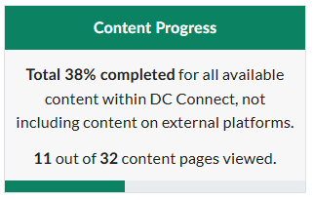
What is the Purpose of the Hub?
The Hub monitors your individual progress in the course, helping you keep on track and moving towards a successful course outcome.
It provides real-time updates on your course average, tracks your course progress, flags assessments that have been missed, and contains a What-If calculator to help calculate course grades.
Content Progress tracker will note the percentage of content pages opened over the course of the semester.

Slide 3
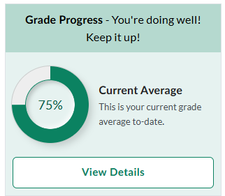
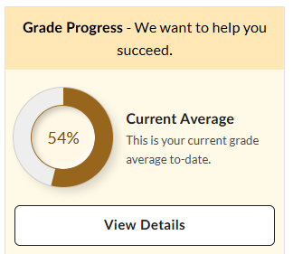
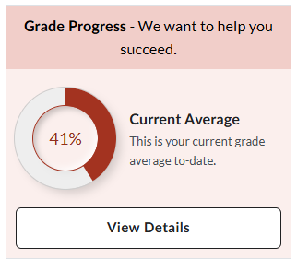
You will see one of three options – it may change throughout the semester
Green
Yellow
Red
The colour is aligned with the grade range of your course average. This updates automatically during the semester as grades are released.

Slide 4
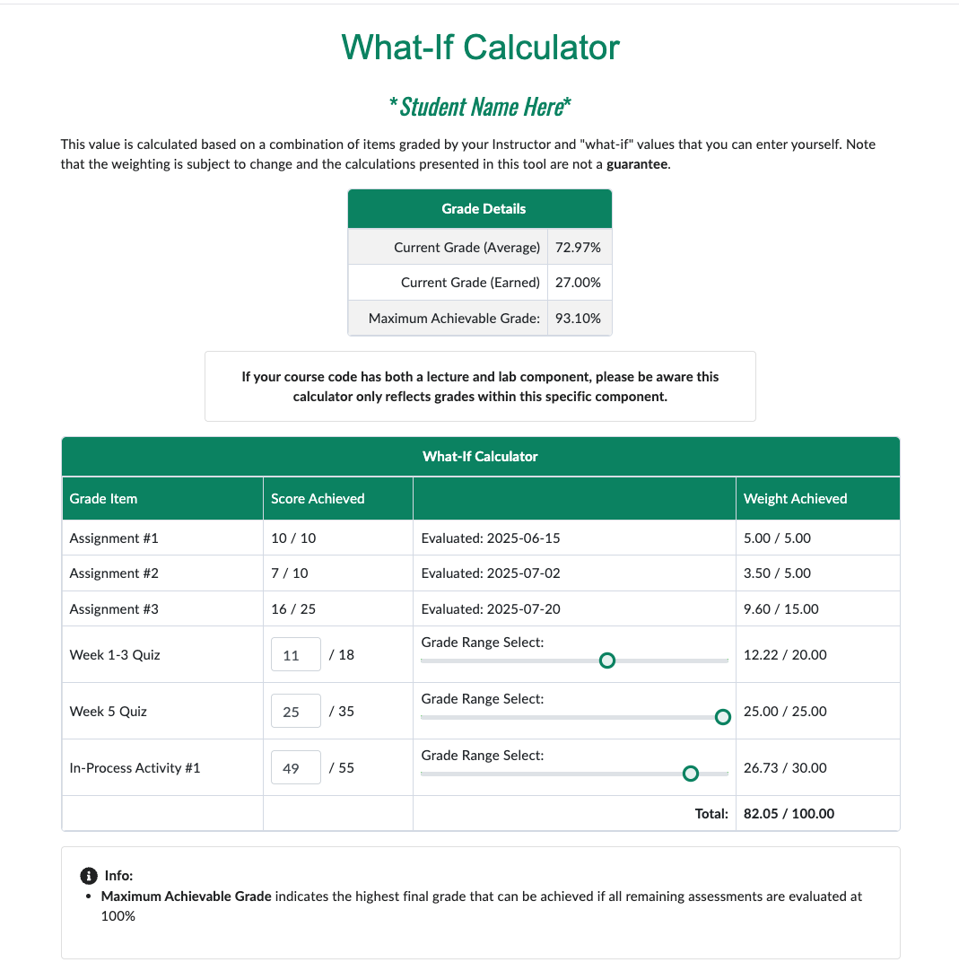
What-If Calculator
The What-If calculator shows you your current grade average and provides an interactive tool to estimate remaining grades in the course to help with planning and reduce anxiety.
Shows you your current grade average and provides an interactive tool to estimate remaining grades in the course to help with planning and reduce anxiety.

Slide 5
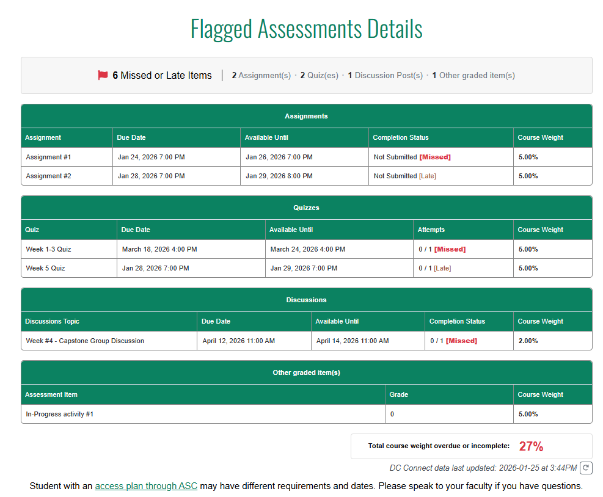

Flagged Assessments
You may see a “flagged assessments” note at the bottom of the Hub. This will pop up if an assignment due date has been missed. When you select this, it will bring up a table to show which assessments have been missed.

Slide 6
Late v.s. Missed Assessments
Late Assessment
Missed Assessment
The end date on DC Connect has passed and you can no longer submit the assessment on DC Connect.
The due date has passed, but you can still submit the assignment on DC Connect.

Slide 7
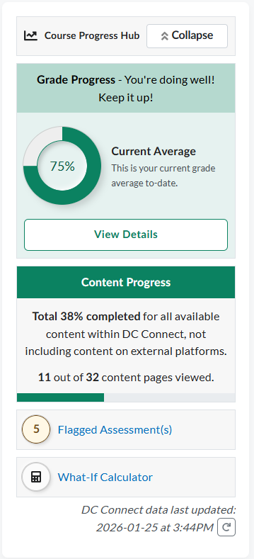
Where you can find it
The Course Progress Hub is automatically integrated into all your courses, and can be found on the top right-hand side of the course homepage.
The Hub visibility is set to be open by default, but you can minimize it each time you access the course by selecting the “Collapse” button at the top of the widget.
The Hub is here to provide an additional support in class. We want to help you succeed!

Slide 8
Course Related Content
*Faculty*
If you would like to add any course specific content related to the hub, please add it here.
Otherwise, this slide can be deleted.

