Slide 1
ADDRESSING ANTI-BLACK RACISM
October 2020

Slide 2
Durham College Statement:
“We stand together in condemning the continued discrimination against, targeting of and oppression of racialized communities. We also recognize and reaffirm our commitment and responsibility to helping dismantle systemic barriers that persist in our own work, campus and greater community.
In the college’s new Strategic Plan, released last week, we articulated our shared values that include diversity and inclusion, respect, integrity and social responsibility. Let us be guided by these principles and each play our role in ensuring they are realized in all aspects of the way we learn, teach, work, live and lead at DC.
We know our students and colleagues are feeling pain, fear and disheartenment, the impacts of which show up in so many ways, not least of all their mental, emotional and physical health.”

Slide 4
THE PLEDGE:
Working through the BlackNorth Initiative, we will increase our efforts to make our workplaces trusting places to have complex, and sometimes difficult conversations about anti-Black systemic racism and ensure that no barriers exist to prevent Black employees from advancing within the company.
We will create and maintain an environment that fosters open dialogue, including listening forums where our people feel comfortable to gain greater awareness of each other’s experiences and perspectives.
By encouraging an ongoing dialogue and not tolerating any incongruence with these values of openness, we are building trust, encouraging compassion and open-mindedness, and reinforcing our commitment to a culture of inclusivity.
Durham College Community Dialogue on Anti-Black Racism
EDI Ambassadors
Social Justice Week
Durham College Black Student Success Network
National Dialogue & Action for Inclusive Higher Education
Notes:
We will create and maintain an environment that fosters open dialogue, including listening forums where our people feel comfortable to gain greater awareness of each other’s experiences and perspectives. By encouraging an ongoing dialogue and not tolerating any incongruence with these values of openness, we are building trust, encouraging compassion and open-mindedness, and reinforcing our commitment to a culture of inclusivity.

Slide 5
Scholar Teach-In:

Slide 6
Working through the BlackNorth Initiative, we will implement or expand unconscious bias and anti-racism education.
Unconscious bias education enables individuals to begin recognizing, acknowledging, and therefore minimizing any potential blind spots they might have.
We will commit to rolling out and/or expanding education that addresses unconscious bias and anti-Black systemic racism within our companies and make non-proprietary unconscious bias education modules available to others free of charge.
DC is committing to increasing its delivery of unconscious bias and anti-racism education – Partnerships: DCSI, BSSN,MAD, CAFÉ, Human Resources, Community Partners
EDI Ambassador Program: Student-led training
EDI Modules in Pedagogy and Practice
CiCan - EDI Internship
EDI Library Resource Microsite
Equity Information Cards

Slide 7
We will share best—and unsuccessful—practices.
We know that many companies are still developing programs and initiatives around true diversity and inclusion. We commit to helping them evolve and enhance their current diversity strategies and encourage them, in turn, to share their successes and challenges with others.
Implement and report on measurable efforts, including new policies, procedures and practices: Equity Policy
Diversity Self-ID Project: Led by EDI Working Group
Membership on Oshawa Community Diversity Equity and Inclusion Committee
Consulting/Advisory support to community partners
Canadian Association for the Prevention of Discrimination and Harassment in Higher Education (CAPDHHE): A case for the review of the racism test to the OHRC

Slide 8
We will create and share strategic inclusion and diversity plans with our board of directors.
We will establish at least one diversity leadership council and make efforts to ensure these groups include diverse representation, including senior Black leaders, within our organization.
The diversity leadership council will work with the CEO who will be accountable to our board of directors (or equivalent governing bodies) through the development and evaluation of concrete, strategic action plans to prioritize and drive accountability around diversity and inclusion, including as it relates to Black employees.
DC’s core values of diversity, inclusion and respect that are named in the 2020-2023 Strategic Plan
Establishment of the college’s first Equity, Diversity and Inclusion Working Group.
Development of a college Equity policy.
Creation of an Equity Action Plan

Slide 9
We will use our resources to work with members of the Black community through the BlackNorth Initiative.
Through the BlackNorth Initiative we will ensure that Black communities across Canada are aware of opportunities of employment within our organization and that employment opportunities are set aside for Black people including committing to specific hiring goals of at least 5% within our student workforce from the Black community.
Through the BlackNorth Initiative we will invest at least 3% of corporate donations and sponsorships to promote investment and create economic opportunities in the Black community, both by 2025.
DC’s Commitment: 3 per cent of its donations create opportunities for the Black community
Strengthening of community partnerships: ABR Taskforce, DRPS, City of Oshawa, Town of Whitby, School Boards
Charter of Commitments and Principles will be the outcome of the National Dialogues and Action
Facilitation, program development, research projects, resource development

Slide 10
We will engage Canada’s corporate governance framework.
The aim of the BlackNorth Initiative is to include both board Chairs and CEOs to foster inclusiveness for Black leaders at the board level, as well as at senior management and executive levels. We are building a strong foundation of business leaders who are committed to meaningful, sustainable inclusion of Black people in business leadership.
Our goal is to build a pipeline so there can be representation from the Black community on the Board of Directors and in our C-suite.
Commitment to work to attract, develop and advance talent to contribute to a target of 3.5 per cent of executive and Board roles held by Black people.
The college’s actions and progress will be accountable through reports to the Board of Governors.
EDI Commitment from an institutional level – Office of Equity, Diversity and Inclusion
Anti-Black Racism Learning - Management Development Series

Slide 11
INSERT SLIDE TITLE HERE

Slide 12
We will create the conditions for success.
As in all business ventures, ‘what gets measured gets managed’, so it’s essential that we collect data on race and ethnicity, including from Black employees, to understand where we have gaps and when we are making progress.
We will work through the BlackNorth Initiative to attract and retain talent from the Black community, and in partnership with our organization’s governance committee, commit to developing and advancing Black people within our organizations to ensure a pipeline of talent as we build inclusive leadership teams that are representative of the communities we serve.
Diversity Self-ID Project
Ongoing Dialogue Sessions
Expand the Black Student Success Network Membership
Strengthen community partnerships: Congress of Black Women, Anti-Black Racism Taskforces, Black Educators Network, Black African Caribbean Outreach, School Boards

Slide 13
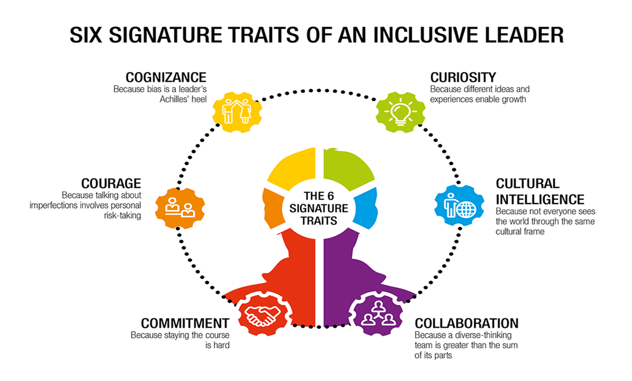

Slide 14
QUESTIONS

