Slide 1
VACCINES AND ENTRY IMMUNIZATION FORMS
THE PROCESS
Teresa Engelage
Patti Cumberland
Nordia Brown-Boothe
December 11th, 2020

Slide 2
Notes:
https://images.app.goo.gl/z9HLb8GBdh96STMA7

Slide 3
PREPARING FOR THE APPOINTMENT
Please bring Entry Immunization Form (EIF) completed with name, Date of Birth, student #, and program information
Please print and bring the EIF to every appointment (if you do not know where to find this, contact your placement officer)
Please provide records of Immunization
If you are an Ontario resident, you can call Public Health for your records at 1-800-841-2729 or 905-666-6241
Please read page 6 and 7 of EIF before appointments- come with questions
Please eat and/or drink before appointments

Slide 4
YOUR HEALTH HISTORY
Note: certain vaccines are contraindicated during pregnancy and/or persons with immunocompromised status.
Note: Live vaccines are contraindicated with TB testing as it renders it ineffective
Blood work- test for Immunity for Varicella (chickenpox), Hep B and may also include MMR
If you are pregnant or plan to become pregnant in the next 3-4 months you may not be able to receive certain vaccines
If you are immunocompromised and which to continue with current medication/treatment regime, be advised that the effectiveness of the vaccines may be less
Certain vaccines required are supplied by you the client. Most are covered by their student plan of about 80% and they may incur a small cost out of pocket

Slide 5
YOUR HEALTH HISTORY
You must complete all vaccine series for full immunization/immunity and it is also a requirement for your program
Regular medications- please disclose even when taking birth control medication
Significant health history- please disclose current and/or past health history that may affect the administration of the vaccines
Any Allergies- please disclose drug, food, etc.
Recent vaccinations- example Flu Vaccines

Slide 6
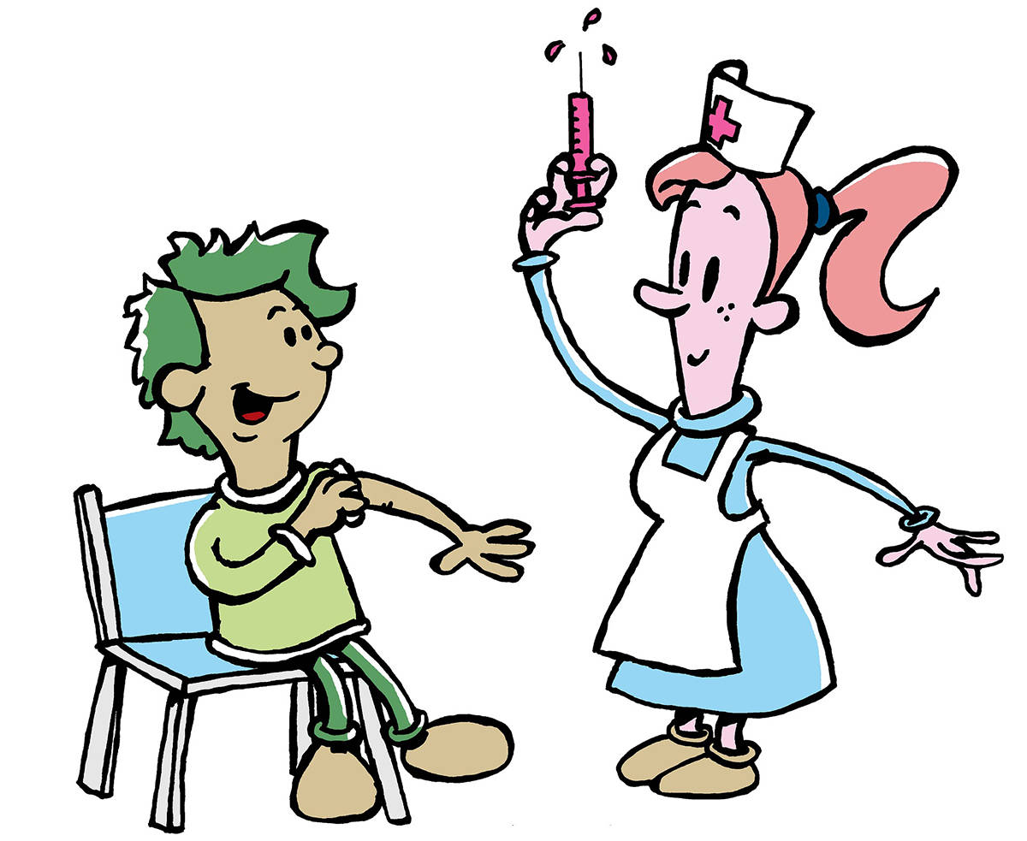
INTRODUCTION TO VACCINES
Notes:
https://images.app.goo.gl/Vgt8FrMWrBCwbfje9

Slide 7
VACCINES- TDaP
Tetanus (lockjaw)-
caused by bacteria in the soil
introduced into the body through a cut or wound
Diphtheria-
caused by bacteria, infects the throat, upper airways, skin
spread through coughing, sneezing, touching eyes, nose, mouth
Pertussis (whooping cough)-
caused by bacteria, easily spread
transmitted with respiratory droplets
Vaccine- Combined called Adacel
the vaccine given by IM (Intramuscular)
the vaccine is valid for 10 years only
Side Effects of Vaccine-
redness, swelling, pain at injection site
Notes:
DIPTHERIA, HEP A&B VARICELLA, INFLUENZA, MEASLES, MUMPS, PERTUSSIS, POLIOMYELITIS, RUBELLA, TETANUS-
https://www.canada.ca/en/public-health/services/publications/healthy-living/canadian-immunization-guide-part-4-active-vaccines.html

Slide 8
VACCINES- Polio, Varicella
Polio-
caused by a virus and causes paralysis, easily spread during the onset of illness
transmitted through contaminated objects especially with fecal matter
Vaccine- called Poliomyelitis
the vaccine is usually given after the 4th birthday
the vaccine is given by S/C (Subcutaneous) or IM (Intramuscular)
the vaccine maybe combined with Adacel for Adacel-Poliomyelitis
Side Effects of Vaccine-
redness
swelling, pain at injection site
Varicella (chickenpox)-
caused by a virus
spread by airborne or direct contact with an infected person
reactivated infection later in life results in Herpes Zoster (Shingles)
Vaccine- called Varivax III
the vaccine is given by S/C (Subcutaneous)
2 dose series given 4-6 weeks apart
live vaccine
Side Effects of Vaccine-
swelling, redness at injection site
fever
Notes:
DIPTHERIA, HEP A&B VARICELLA, INFLUENZA, MEASLES, MUMPS, PERTUSSIS, POLIOMYELITIS, RUBELLA, TETANUS-
https://www.canada.ca/en/public-health/services/publications/healthy-living/canadian-immunization-guide-part-4-active-vaccines.html

Slide 9
VACCINES- MMR
Measles-
caused by a virus, highly contagious, easily spread by airborne-aerosolized-inhaled droplet, and direct contact with an infected person
characterized by fever, pink eye, cough, a maculopapular rash on face, then spreads to behind ears, trunk and extremities
may lead to other serious complications such as encephalitis, otitis media, pneumonia
Mumps-
spread by large respiratory droplets and direct contact with an infected person
characterized by fever, swelling of one or more salivary glands
may cause sterility in males
Rubella-
caused by a virus, contagious, transmitted by large respiratory droplets
characterized by mild rash, illness, mild conjunctivitis
may cause congenital Rubella Syndrome
Vaccine- called MMR
vaccine in 2 dose series (usually)
live vaccine
EIFs- usually receive 1 booster dose
Side Effects of Vaccine-
pain, and redness at the injection site
rash, fever
Notes:
MUMPS, MEASLES, RUBELLA, PERTUSSIS, TUBERCULOSIS, VARICELLA-ZOSTER, INFLUENZA-
Surveillance Protocol for Ontario Hospitals and Ontario Medical Association
Joint Communicable Diseases Surveillance Protocols Committee in Collaboration with the Ministry of Health and Long-term Care
Published and Distributed by the Ontario Hospital Association, Published June 1990, Reviewed and Revised June 2018

Slide 10
VACCINES- HEPATITIS B
Hepatitis B-
caused by a virus
spread through unprotected sexual activity
sharing injection drug equipment
chronic infection, can lead to serious liver disease
signs & symptoms- anorexia, abdominal pain, nausea, vomiting
jaundice (yellowing of the skin and eyes)
Vaccine- called Energix-B
administered via IM (Intramuscular)
Hepatitis B vaccine is given in 3 doses- month 0, month 1, and month 6
If Hepatitis A & B are given together (Twinrix) then follow 3 dose series
Side Effects of Vaccine-
pain, soreness, redness
swelling at injection site
irritability, headache, fatigue
Hep A- malaise, fever, gastrointestinal symptoms
Notes:
DIPTHERIA, HEP A&B VARICELLA, INFLUENZA, MEASLES, MUMPS, PERTUSSIS, POLIOMYELITIS, RUBELLA, TETANUS-
https://www.canada.ca/en/public-health/services/publications/healthy-living/canadian-immunization-guide-part-4-active-vaccines.html

Slide 11
VACCINES- INFLUENZA
Influenza-
an acute respiratory infection caused by the Influenza A & B virus
characterized by sudden onset of fever, cough, myalgia (muscle pain), headache, chills, loss of appetite, fatigue, sore throat
Vaccine- called FluZone, FluLaval Tetra
administered via IM (Intramuscular) injection
safe, and well tolerated
will not cause Flu illness- due to does not contain a live virus
Side Effects of Vaccine-
pain, soreness at the injection site
nasal congestion, runny nose
Notes:
DIPTHERIA, HEP A&B VARICELLA, INFLUENZA, MEASLES, MUMPS, PERTUSSIS, POLIOMYELITIS, RUBELLA, TETANUS-
https://www.canada.ca/en/public-health/services/publications/healthy-living/canadian-immunization-guide-part-4-active-vaccines.html

Slide 12
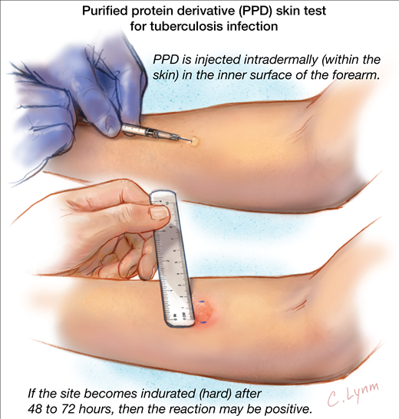
INTRODUCTION TO TB
Notes:
https://images.app.goo.gl/5VJq23cPeLdNAdVw9

Slide 13
TB (TUBERCULIN TESTING)
Active TB-
A curable, treatable and preventable, caused by bacteria, may lead to death
Infectious disease, communicable, respiratory route
Modes of transmission- airborne, face-to-face contact considered significant in transmission
Signs & symptoms- persistent cough, bloody sputum, night sweats, weight loss, anorexia, fever
Latent TB-
Exposed, infection occurs, but no active TB disease

Slide 14
TB (TUBERCULIN TESTING
TST (Two-Step Tuberculin Skin Test)-
Administered via Intradermal injection
Please note- TB test are not available on Thursdays
It takes approximately 2 weeks to conduct 2-step testing
The initial test administered on day one- results to be read in 48-72 hours
At least one week after- second test is administered, results to be read 48-72 hours
The TB skin test will show if someone has been exposed to the TB germ and produced antibodies
If at any time during testing, first or second, the results are 10mm or more, the person will require further testing such as a Chest X-Ray and a Doctor’s exam to ensure the person does not have active TB
Notes:
TB-
https://apps.who.int/iris/bitstream/handle/10665/336069/9789240013131-eng.pdf?%20ua=1
http://www.bccdc.ca/resource-gallery/Documents/Communicable-Disease-Manual/Chapter%204%20-%20TB/TB_manual_IGRA_guidelines.pdf

Slide 15
TB (TUBERCULIN TESTING)
Test and possible outcomes-
0.1ml of Tubersol injected Intradermal (just below surface of the skin)
elevation area of the skin (a wheel, bubble) appears
wheel typically disappears after 10-15 minutes
may have small amounts of blood- do not cover, massage the area
site/area maybe itchy, do not scratch the area
continue to perform normal activities
Notes:
TST (TB SKIN TEST)-
https://phac-aspc.gc.ca/tbpc-latb/pubs/tb-canada-7/assets/pdf/tb-standards-tb-normes-ch4-eng.pdf
https://www.durham.ca/en/health-and-wellness/tuberculosis-tb.aspx

Slide 16
WHAT TO EXPECT
EIFs-
Includes at least 4-5 visits (2 weeks) to complete form, may extend to more visits depending on bloodwork results, TB testing, need for Chest X-Rays, need for follow-up vaccines, etc.
If forms are due by a specific date- you need to give yourself at least 3 weeks for completion, that is book an appointment at least 3 weeks before EIF due date
Some vaccines require a Medical Doctor’s appointment and a Prescription
The form fee will be billed at your first appointment
Take a copy of your completed form prior to handing it in to your placement officer

Slide 17
REFERENCES
TB- https://apps.who.int/iris/bitstream/handle/10665/336069/9789240013131-eng.pdf?%20ua=1
http://www.bccdc.ca/resource-gallery/Documents/Communicable-Disease-Manual/Chapter%204%20-%20TB/TB_manual_IGRA_guidelines.pdf
BCG- https://Canada.ca/en/public-health/services/publications/healthy-living/Canadian-immunization-guide-part-4-active-vaccines/page-2-bacille-colmette-guerin-vaccine.html
https://www.cdc.gov/tb/publications/factsheets/prevention/bcg.htm
DIPTHERIA, HEP A&B VARICELLA, INFLUENZA, MEASLES, MUMPS, PERTUSSIS, POLIOMYELITIS, RUBELLA, TETANUS- https://www.canada.ca/en/public-health/services/publications/healthy-living/canadian-immunization-guide-part-4-active-vaccines.html
ALL VACCINES- Durham College Campus Health & Wellness Center Policy and Procedure. Revised July 2020

Slide 18
REFERENCES
MUMPS, MEASLES, RUBELLA, PERTUSSIS, TUBERCULOSIS, VARICELLA-ZOSTER, INFLUENZA- Surveillance Protocol for Ontario Hospitals and Ontario Medical Association
Joint Communicable Diseases Surveillance Protocols Committee in Collaboration with the Ministry of Health and Long-term Care
Published and Distributed by the Ontario Hospital Association, Published June 1990, Reviewed and Revised June 2018
TST (TB SKIN TEST)- https://phac-aspc.gc.ca/tbpc-latb/pubs/tb-canada-7/assets/pdf/tb-standards-tb-normes-ch4-eng.pdf
https://www.durham.ca/en/health-and-wellness/tuberculosis-tb.aspx
TB TREATMENT- https://www.durham.ca/en/health-and-wellness/resources/Documents/IllnessInfectionDisease/RifampinFA.pdf
https://www.cdc.gov/tb/publications/pdf/Rif_508.pdf
https://artlist.io/?search=origami

Slide 19
Campus Health and Wellness Centre
OSHAWA. CAMPUS
OSHAWA CAMPUS
2000 Simcoe St. N. Oshawa, ON, Canada L1G 0C5
N. T: 905.721.3037 F: 905.721.3133 E: chwc@durhamcollege.caa, ON, Canada L1G 0C5

