Slide 1
Cybersecurity - Social Media Privacy and Safety

Slide 2
Cybersecurity – Social Media Privacy and Safety
In this session we will discuss risks related to the use of social media and cell phones, and we will share advice on how to protect yourself online.
We will also learn new Cybersecurity Terms, have time for an activity related to them and Win a Prize!!!
Kamaljeet Batra
Kamaljeet.batra@durhamcollege.ca
Elizabeth Tellez
Elizabeth.tellez@durhamcollege.ca

Slide 3
TikTok Case Study
Please work on a team of 4 students and answer the questions
Samantha is on grade 8, and she loves sharing videos on Tik Tok. Last week she was friended by Frank, he is 17 and he looks very handsome on his pictures. Sam is really excited to talk to him and she started sharing her hobbies, her favorite music, she discovered he also likes Billie Eilish! And he is friendly and open minded! Frank asked her to collaborate on a video to get more likes, she was super excited and accepted. ‘Frank has a lot of likes on his videos’, she thought, ‘this is a great opportunity’. She sent the video to Frank because she thinks ‘Frank is older and Frank knows better’. Then Frank got a lot of likes on her video and he asked for more personal videos, this time telling her how to pose in order to get more and more likes! Samantha sent more videos and Voila! Hundreds of likes, she is so excited!! Frank then said: ‘I’m interested in meeting you, let’s meet at the park, but don’t tell your parents, we are going to get a lot of hype!!!!!

Slide 4
TikTok Case Study – Activity sheet 1
What would you do if you were Samantha? Would you meet Frank at the park?
Why?
If Sam decides to go, what steps should she take to ensure her safety?

Slide 5
TikTok Case Study-Discussion
Please share your thoughts – team leader
What happened with Frank and Samantha
Red flags
Software that manipulates faces and movements

Slide 6
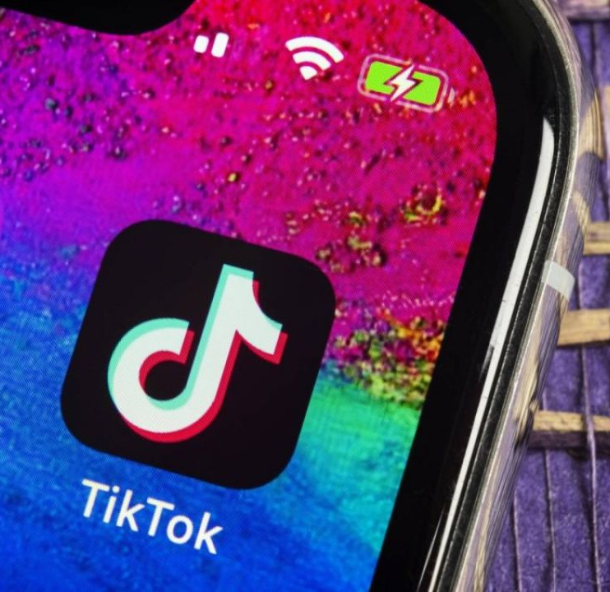
How can Sam protect herself online?
Locking her account
Talking to adults she feels comfortable with, if something looks/feels weird or uncomfortable
Only accepting requests from people she knows and is connected to
Managing who is seeing her content
This Photo by Unknown author is licensed under CC BY-NC-ND.
Notes:
3.2 – Safeguarding Your Online Privacy
3.2.2 – Sharing Too Much Information?
3.2.2.1 – Do Not Share Too Much on Social Media

Slide 7
Mobile FTP video

Slide 8
Cyber Security Terms
Notes:
3 – Protecting Your Data and Privacy
3.2 – Safeguarding Your Online Privacy

Slide 9
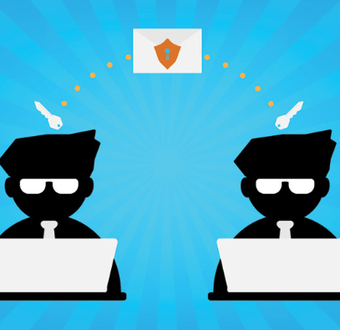
Cyber Security Terms
Cookies
Small files your Browser saves on your computer. They often include data like your login and password.
Data theft
Your financial and personal data can be very valuable in the wrong hands.
Identity spoofing
It’s easy to pretend to be someone else online. There are lots of fake Facebook, Instagram profiles and Twitter accounts that pretend to be from someone they’re not.

Slide 10
Cyber Security Terms
Malware
These programs — which may pretend to be something useful or install themselves by getting you to click a box — can hurt your computer or even take control of it.
Phishing Scams
E-mails that try to get data from you by pretending to be from a bank or other business.
Spyware
Malware that collects data from your computer. Some spyware records everything you type.

Slide 11
Cyber Security Terms
Cybersquatting
Scammers may register a Web address that looks like it belongs to a legitimate business, or one that can easily be typed be accident when navigating to a legitimate Web site

Slide 12
Safeguarding Your Online Privacy
Notes:
3 – Protecting Your Data and Privacy
3.2 – Safeguarding Your Online Privacy

Slide 13
Tools to use:
Browser and antivirus updates
Clearing browser cache
Privacy policies
Private browsing tools
Secure sites
(Practical implementation of the tools)
Notes:
3.2 – Safeguarding Your Online Privacy
3.2.2 – Sharing Too Much Information?
3.2.2.1 – Do Not Share Too Much on Social Media

Slide 14
Time for Activity and Win a Prize!
Notes:
3 – Protecting Your Data and Privacy
3.2 – Safeguarding Your Online Privacy

Slide 15
Instructions for this Activity
We will read three scenarios and every team will identify them according to the cybersecurity terms we just learned.
Every team has to write down their answers on a paper and give it to the classroom teacher.
The team that answers first and correctly, is the winner!
This Photo by Unknown Author is licensed under CC BY-ND

Slide 16
Cyber Security Scenarios
Scenario 1
You were in a hurry to check your Facebook account this morning so you accidentally typed www.facebok.com. Instead of going to Facebook, you landed on a site that’s advertising orthopedic shoes!

Slide 17
Cyber Security Scenarios
Scenario 2
When you went to school today your best friend was really mad at you. It turned out that she thought you had left some really mean comments on her Instagram page — but you didn't write them.

Slide 18
Cyber Security Scenarios
Scenario 3
Yesterday you tried to log into your Instagram account but found out that somebody had changed your password. Then you found out your password had been changed on all of your online accounts. Your big brother did a scan of your computer and found a program on it that was recording everything you typed, including your login information for all your accounts.

Slide 19
Cyber Security Careers

Slide 20
Sources
Media Smarts (https://mediasmarts.ca)
Victim Services Durham Region (https://www.victimservicesdurham.ca/home )

